Slide 1
Hearing Systems – Part 1 of 2
https://hearingsystems.github.io/
TU Ilmenau – Audio Systems Technology
(Online) | 20. Januar 2021
Dr.-Ing. Tamas Harczos

Slide 2
Introduction
Hearing Systems - Introduction
Two lectures (with one short break, each) and one seminar.
Useful links:
https://hearingsystems.github.io/,
https://www.tu-ilmenau.de/mt/lehrveranstaltungen/lehre-fuer-master-mt/audio-systems-technology/.
Topics we will cover:
Basics: units, hearing, hearing loss, tonotopy, dynamic range & compression.
Devices: hearing aids, cochlear implants, optogenetic stimulation, hearables.
Technologies: audiological features, fitness & medical features, hardware & software.
Current trends in research & development.

Slide 3
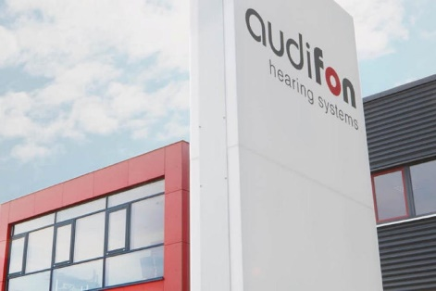
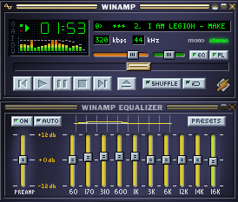
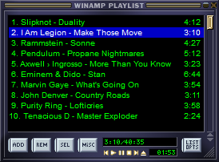
Introduction
Hearing Systems - Introduction
audifon:
audifon GmbH & Co. KG develops, produces and sells hearing systems
Headquarter located in Kölleda, Thüringen (also place of production)
R&D offices in Köln and Ilmenau (System / Embedded SW Engineering)
About 200 employees
myself:
First home computer generation
Programming as an early hobby (Basic → Pascal → C/C++)
Interested in audio and audio signal processing
M.Sc. Information Technology (Veszprém, Hungary) Ph.D. Biomedical Technology (Ilmenau)

Slide 4
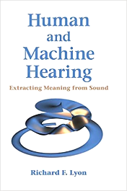

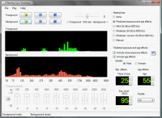
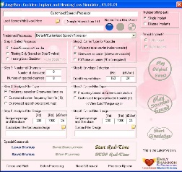
Further resources
Hearing Systems - Introduction
Books:
Hörakustik 3.0 - Theorie und Praxis (Jens Ulrich, Eckhard Hoffmann), ISBN: 978-3-9428-7336-9
Auditory Prostheses: New Horizons (Zeng, Popper, Fay, eds.), ISBN: 978-1-4419-9434-9
Human and Machine Hearing (Richard F. Lyon), ISBN: 978-1-1070-0753-6, see draft online
Programming / Testing:
Oldenburg openMHA (Master Hearing Aid)
Hearing Loss Simulator (CDC, USA)
Cochlear implant (CI) and hearing loss simulator (AngelSim)
CI simulation (UT Dallas, USA), CI simulation (UGR, Spain)

Slide 5
Ready?
Hearing Systems - Introduction
Face-off

Slide 6
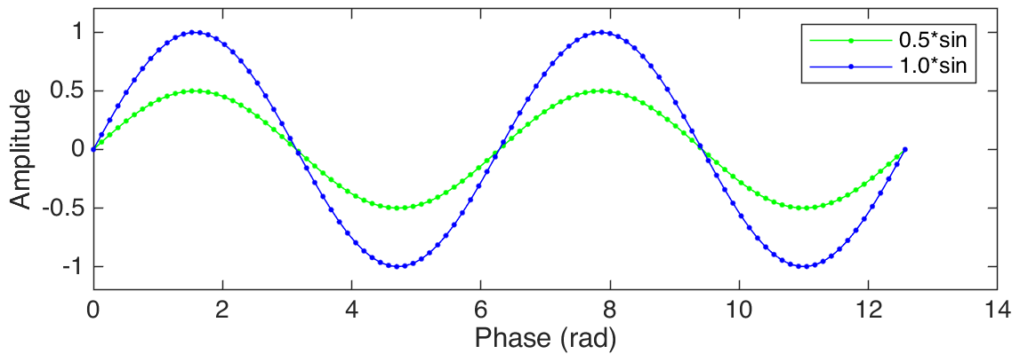
Scales and units in audio signal processing
First of all: Decibel (dB) alone is not a unit, it’s a scale. It describes a relationship between two levels.
Definition for (sound) amplitudes: A_{dB}=20 log₁₀ (AmplitudeRatio), meaning:
if AmplitudeRatio=A1/A2=1/100 → 20log₁₀(1/100)= -40dB,
if AmplitudeRatio=A1/A2=1/10 → 20log₁₀(1/10)= -20dB,
if AmplitudeRatio=A1/A2=1/2 → 20log₁₀(1/2)= -6.02dB≈-6dB.
The unit dB FS (Decibel full scale): relates to the maximum output of the given system.
E.g.: Audio sample amplitudes in MATLAB are in range [-1, +1) → 0dBFS means |signal| values approach 1.
0 dB FS
Further increase in amplitude → clipping.

Slide 7
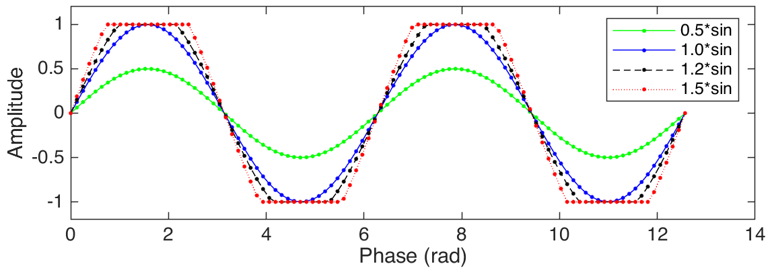

Scales and units in audio signal processing
First of all: Decibel (dB) alone is not a unit, it’s a scale. It describes a relationship between two levels.
Definition for (sound) amplitudes: A_{dB}=20 log₁₀ (AmplitudeRatio), meaning:
if AmplitudeRatio=A1/A2=1/100 → 20log₁₀(1/100)= -40dB,
if AmplitudeRatio=A1/A2=1/10 → 20log₁₀(1/10)= -20dB,
if AmplitudeRatio=A1/A2=1/2 → 20log₁₀(1/2)= -6.02dB≈-6dB.
The unit dB FS (Decibel full scale): relates to the maximum output of the given system.
E.g.: Audio sample amplitudes in MATLAB are in range [-1, +1) → 0dBFS means |signal| values approach 1.
0 dB FS
Further increase in amplitude → clipping.

Slide 8
Scales and units in audio signal processing
First of all: Decibel (dB) alone is not a unit, it’s a scale. It describes a relationship between two levels.
Definition for (sound) amplitudes: A_{dB}=20 log₁₀ (AmplitudeRatio), meaning:
if AmplitudeRatio=A1/A2=1/100 → 20log₁₀(1/100)= -40dB,
if AmplitudeRatio=A1/A2=1/10 → 20log₁₀(1/10)= -20dB,
if AmplitudeRatio=A1/A2=1/2 → 20log₁₀(1/2)= -6.02dB≈-6dB.
The unit dB FS (Decibel full scale): relates to the maximum output of the given system.
E.g.: Audio sample amplitudes in MATLAB are in range [-1, +1) → 0dBFS means |signal| values approach 1.
0 dB FS
Further increase in amplitude → clipping.
Conversion: dB = 20 log₁₀(mag) ←→ mag= 10^{(dB/20)}

Slide 9
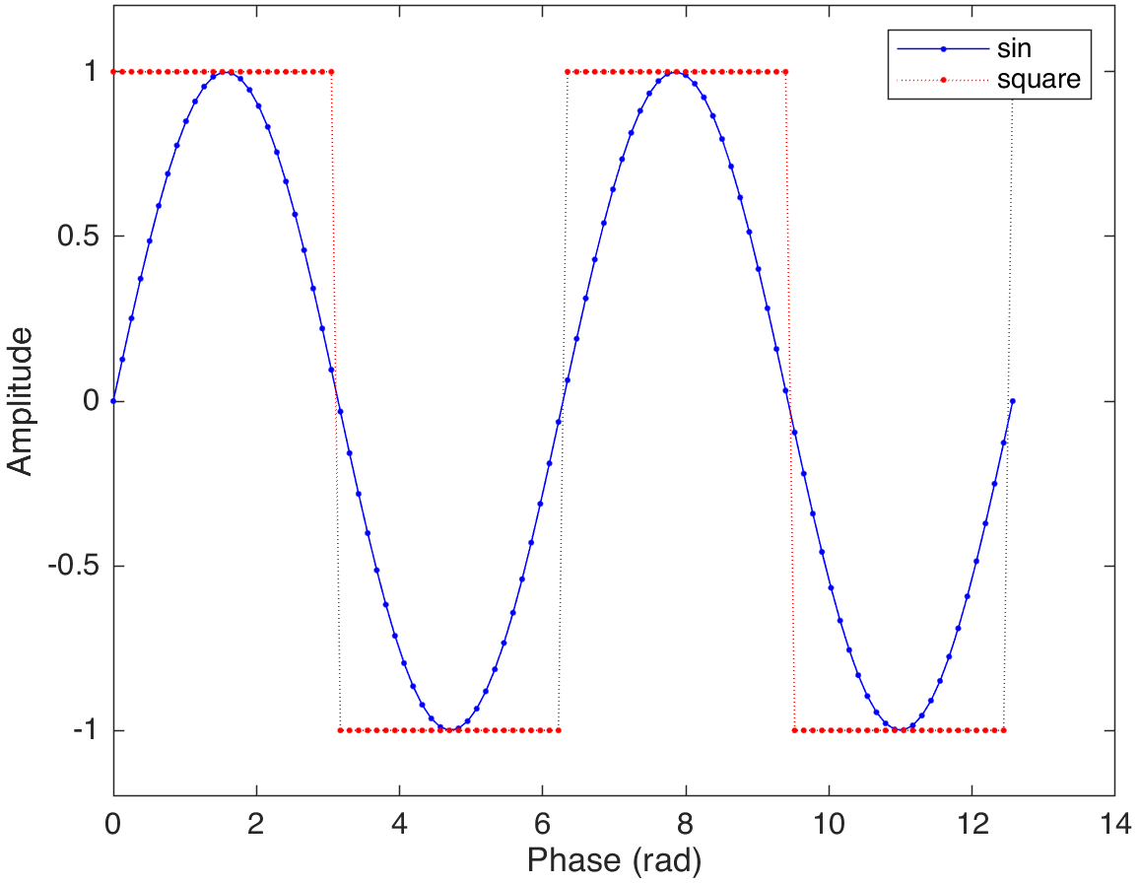
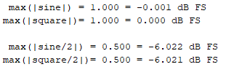
Scales and units in audio signal processing: dB FS
The peaks (dB FS) of a signal do not necessarily reveal its impact on “loudness”. Calculating the RMS (root-mean-square) of chunks of samples helps → signal form matters!

Slide 10
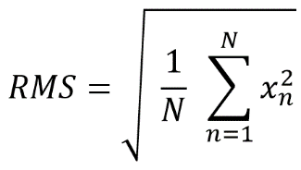
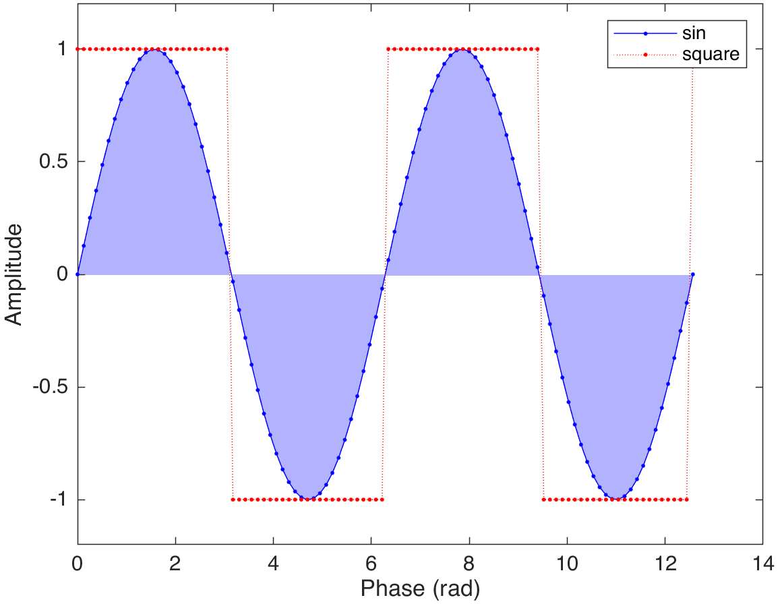
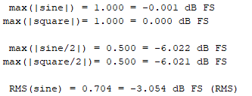
Scales and units in audio signal processing: dB FS (RMS)
The peaks (dB FS) of a signal do not necessarily reveal its impact on “loudness”. Calculating the RMS (root-mean-square) of chunks of samples helps → signal form matters!

Slide 11
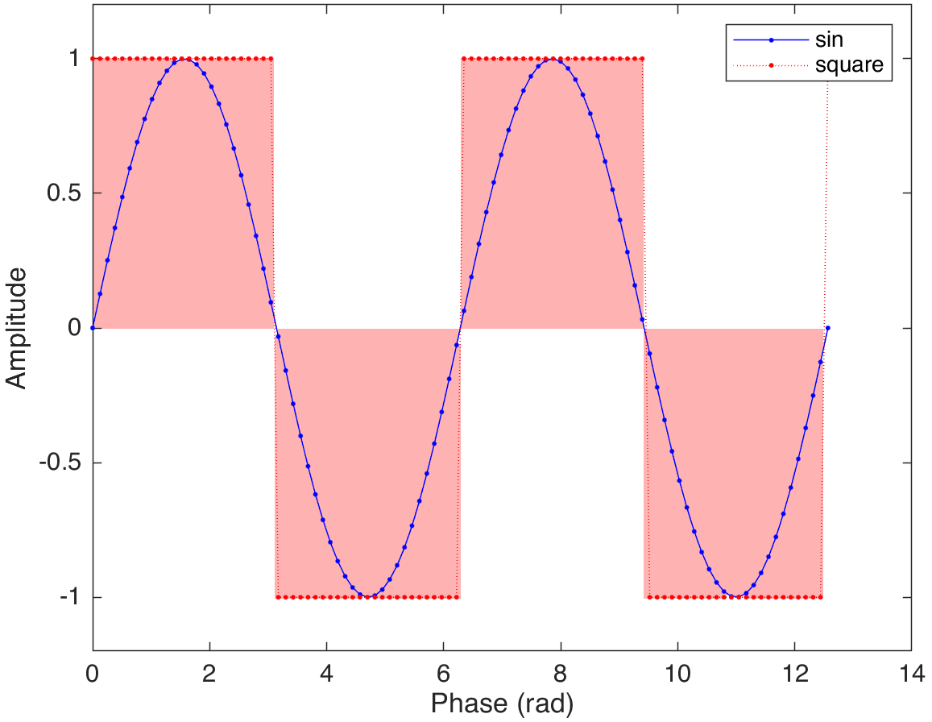
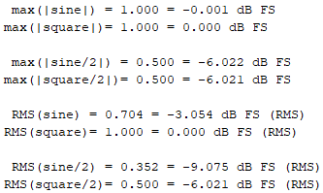
Scales and units in audio signal processing: dB FS (RMS)
The peaks (dB FS) of a signal do not necessarily reveal its impact on “loudness”. Calculating the RMS (root-mean-square) of chunks of samples helps → signal form matters!

Slide 12
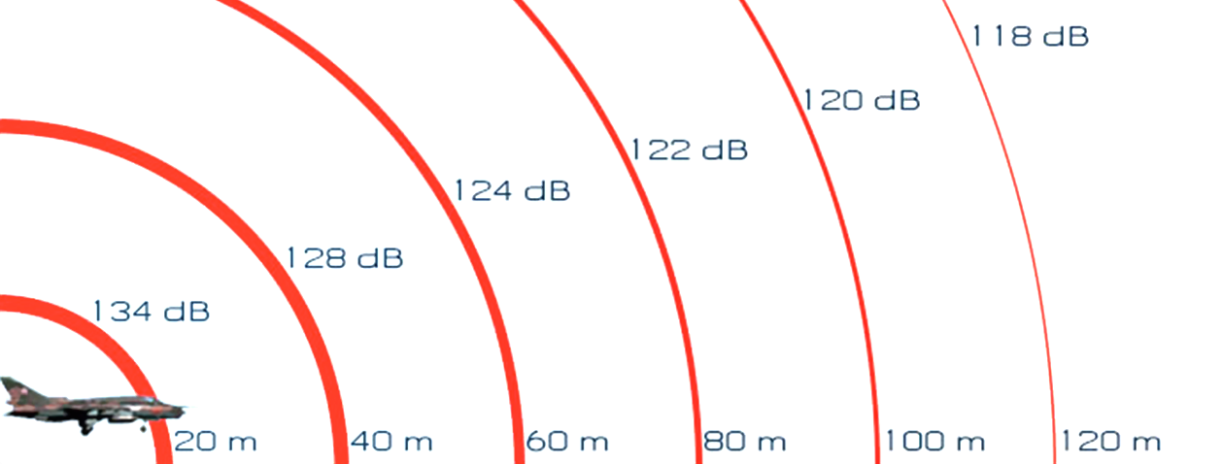
Scales and units in audio signal processing
The unit dB SPL (Decibel sound pressure level): relates to the reference sound pressure p₀=20μPa in air (often considered as the threshold of human hearing). Definition: B_{dB SPL}=20 log₁₀ (p/p₀).
Distance (source to receiver) is important, 1m is frequently used as standard distance.
Doubling the distance halves the SPL (in free field).

Slide 13
Scales and units in audio signal processing
The unit dB SPL (Decibel sound pressure level): relates to the reference sound pressure p₀=20μPa in air (often considered as the threshold of human hearing). Definition: B_{dB SPL}=20 log₁₀ (p/p₀).
Distance (source to receiver) is important, 1m is frequently used as standard distance.
Doubling the distance halves the SPL (in free field).
Typical ranges:
20-30 dB SPL: very calm room,
40-60 dB SPL (1m): normal conversation,
70-90 dB SPL (10m): nearby heavy traffic,
100-110 dB SPL (1m): jack hammer / chain saw,
120 dB SPL (100m): jet engine,
194 dB SPL: largest pressure variation an undistorted sound wave can have in Earth's atmosphere.
>85 dB SPL: Hearing damage over long-term exposure
>120 dB SPL: Instantaneous noise-induced hearing loss

Slide 14
Scales and units in audio signal processing: Equal-loudness contours
1933: Fletcher & Munson (JASA)
1956: Robinson & Dadson (BJAP)
2003: Multisite study → ISO 226
Averaged over many normal hearing (NH) listeners
At 1000 Hz: dB SPL ≈ loudness.
At other frequencies, e.g. at 50 Hz (mainly at higher levels) not.
Loudness perception is frequency dependent and non-linear.

Slide 15
Scales and units in audio signal processing: dB HL
Equal loudness contours

Slide 16
Scales and units in audio signal processing: dB HL
Equal loudness contours
Pure tone audiogram
Example: high pitched hearing loss
125
250
500
1k
2k
3k
4k
Measurement called: Pure tone audiometry
6k

Slide 17
Scales and units in audio signal processing: dB HL
Equal loudness contours
Pure tone audiogram (PTA)
Bisgaard standard audiograms:
S1: very mild (degree of hearing loss)

Slide 18
Scales and units in audio signal processing: dB HL
Equal loudness contours
Pure tone audiogram (PTA)
Bisgaard standard audiograms:
S1: very mild (degree of hearing loss)
S2: mild

Slide 19
Scales and units in audio signal processing: dB HL
Equal loudness contours
Pure tone audiogram (PTA)
Bisgaard standard audiograms:
S1: very mild (degree of hearing loss)
S2: mild
S3: severe Source: Bisgaard et al. (2010)

Slide 20
Scales and units in audio signal processing: dB HL
Equal loudness contours
Pure tone audiogram (PTA)
Bisgaard standard audiograms:
S1: very mild (degree of hearing loss)
S2: mild
S3: severe Source: Bisgaard et al. (2010)
D: hearing loss bordering on deafness

Slide 21
Hearing and hearing impairments
Pure tone audiogram (PTA)

Slide 22
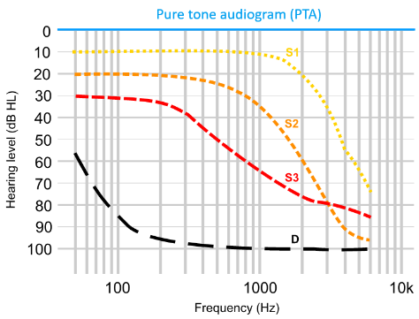
Hearing and hearing impairments
Questions:
How many are affected?
WHO 2020: worldwide ca. 466M people with disabling hearing loss.
How bad is impaired hearing?
It is bad, especially in background noise. Try for yourself → see slide 4: hearing loss simulators.
What are the causes of the impairments?
Genetic causes, complications at birth, infectious diseases, chronic ear infections, certain drugs, ageing, and exposure to excessive noise (1.1B young people under 35 due to high SPLs in recreational settings).
What can be done to help people?
Hearing protection and education, access to early and on-demand screening;
access to hearing systems: hearing aids, cochlear implants, and other assistive devices (WHO 2020: currently only 17% of those who could benefit from use of a hearing aid actually use one);
sign language and social support.

Slide 23
Short recap
Scales (→dB) and main units (→dB FS) in audio signal processing, conversion: dB = 20 log₁₀(mag) ←→ mag= 10^{(dB/20)}.
Importance of signal form (→dB RMS) and distance (→dB SPL) and how they influence loudness (→equal loudness contours).
Hearing level (→dB HL) and pure tone audiogram.
Facts about hearing impairments.

Slide 24
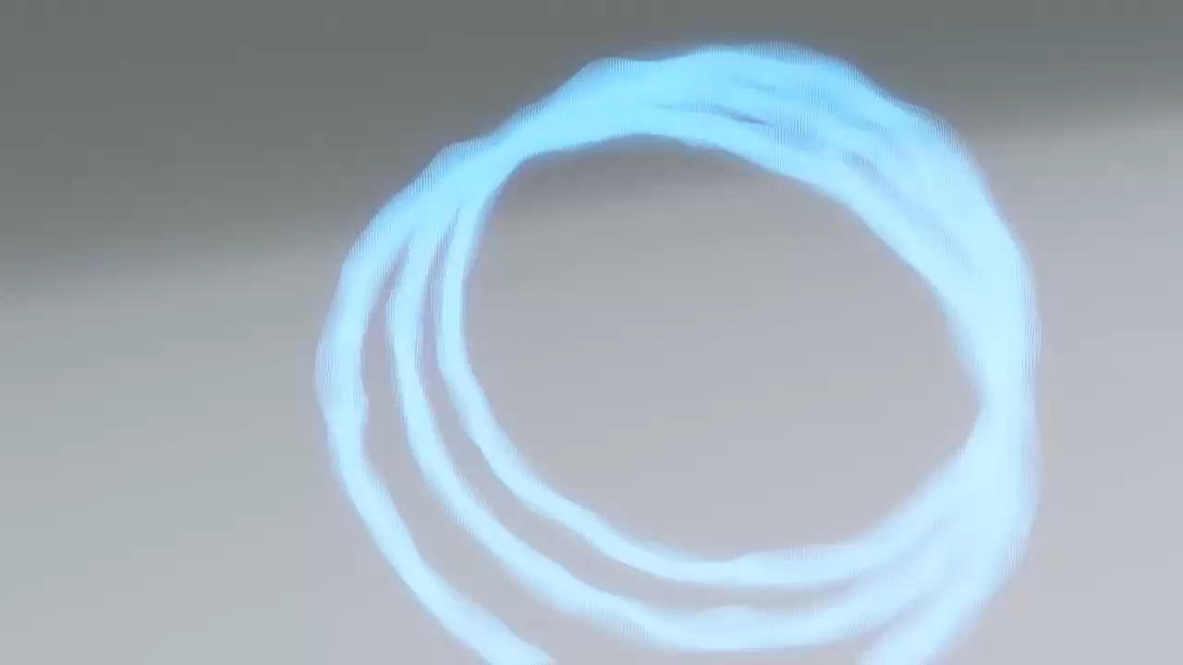
How hearing works

Slide 25
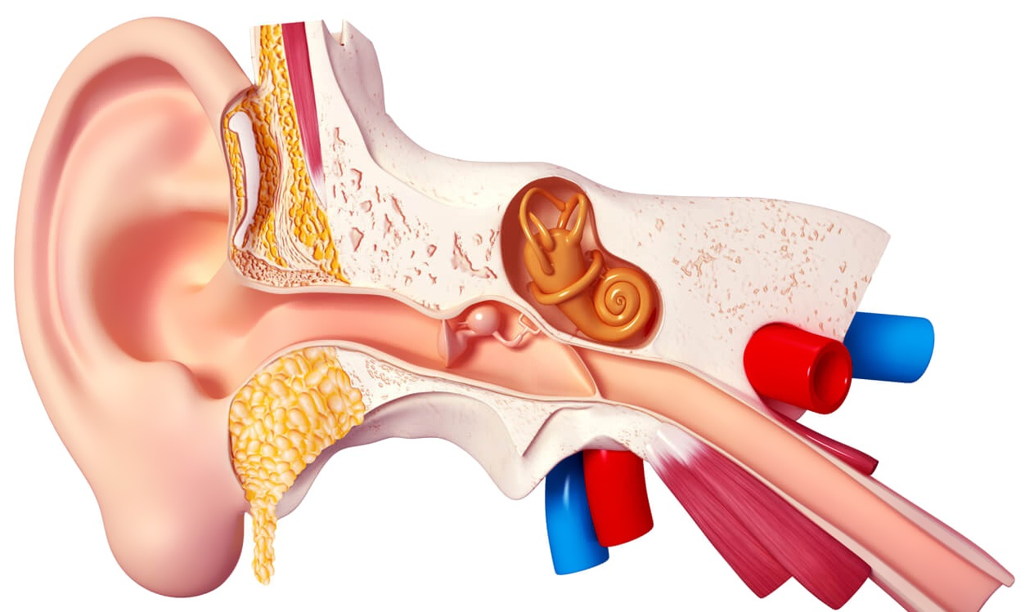
Overview
Outer ear: amplification, direction-dependent filtering.
Middle ear:
impedance matching (air to fluid),
protection of the inner ear.
Inner ear:
spectral decomposition of signal (~filter bank),
transformation into electrical signals (neural spikes).
Source: www.lobe.ca, 2021.

Slide 26
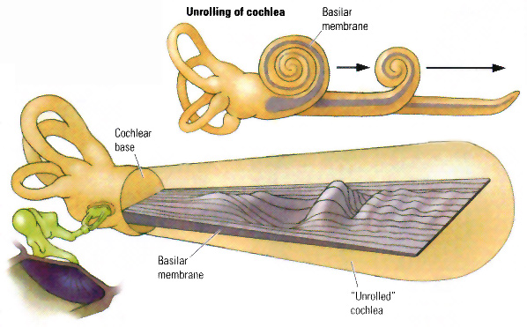
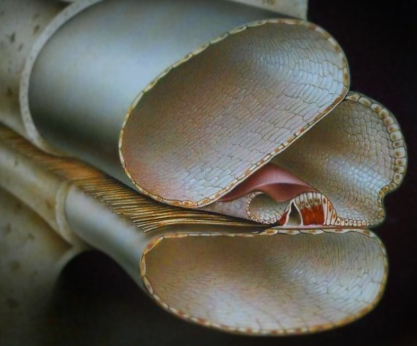
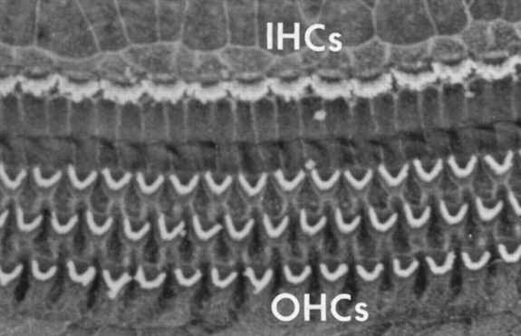
How hearing works
Unrolled cochlea
Cochlear cross-section
Source: http://www.pc.rhul.ac.uk
Source: www.meniett.com
Organ of Corti
Adapted from: Baumgarte, 2000
Hair cell rows
Source: Ryan, 2000

Slide 27
How hearing works: Inner hair cells
Organ of Corti
Adapted from: Baumgarte, 2000
Source: Brown & Santos-Sacchi, 2014
Inner hair cells:
do mechanoelectrical transduction (convert motion to electricity);
are the sensory cells in our auditory system.

Slide 28
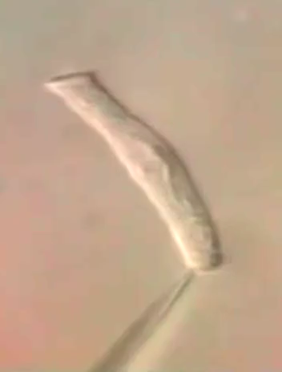
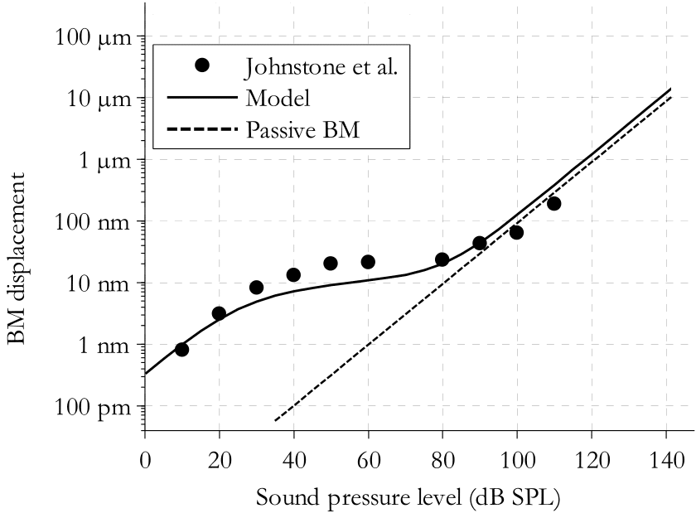
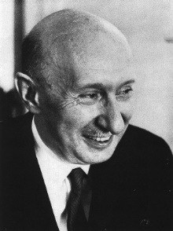
How hearing works: Outer hair cells
OHC motility
BM nonlinearity
Organ of Corti
Damage →
Active BM
Adapted from: Johnstone, Patuzzi, Yates, 1986
Adapted from: Baumgarte, 2000
Source: J. Ashmore for BBC ‘Ear we go‘, 1987
Outer hair cells (OHCs):
actively amplify/dampen the movement of the basilar membrane (BM), thus increase the loudness range (dynamic range) of the ear;
increase frequency selectivity at the basilar membrane;
protect inner hair cells by stiffening upon loud signals (until damaged).
Békésy György, 1899-1972 Biophysicist Nobel-prize 1961 awardee

Slide 29
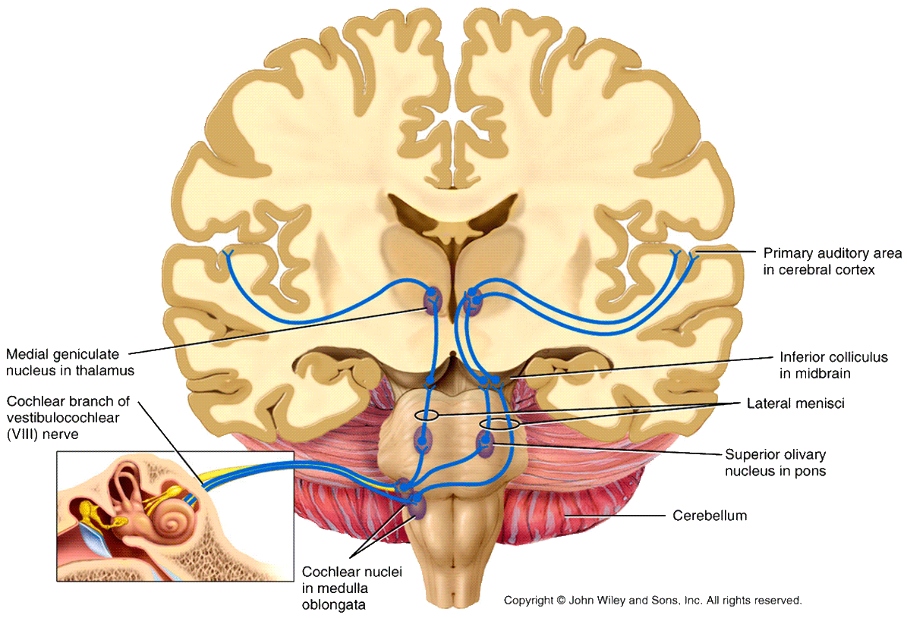
Auditory pathway
Source: Tortora & Derrickson: Principles of Anatomy and Physiology, 2016

Slide 30
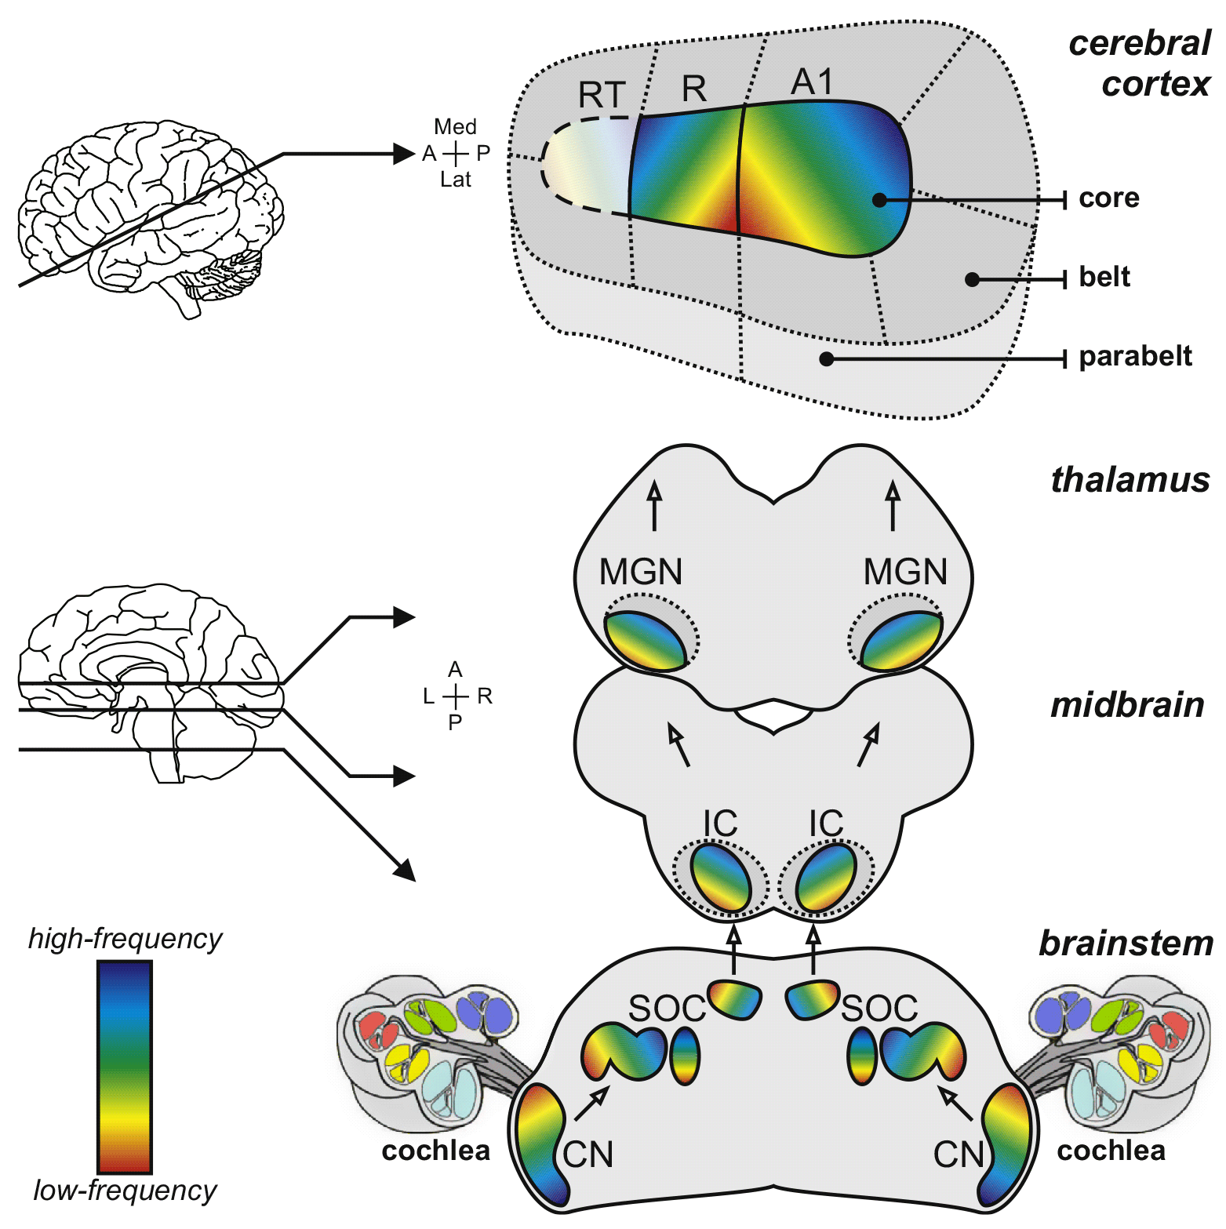
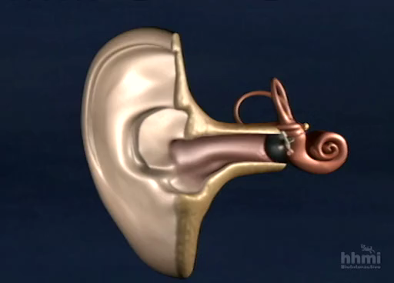
Tonotopy
Source: HHMI, 2000.
Tonotopy is the spatial arrangement of where sounds of different frequencies are processed in the auditory nervous system.
Source: Saenz & Langers, 2014.

Slide 31
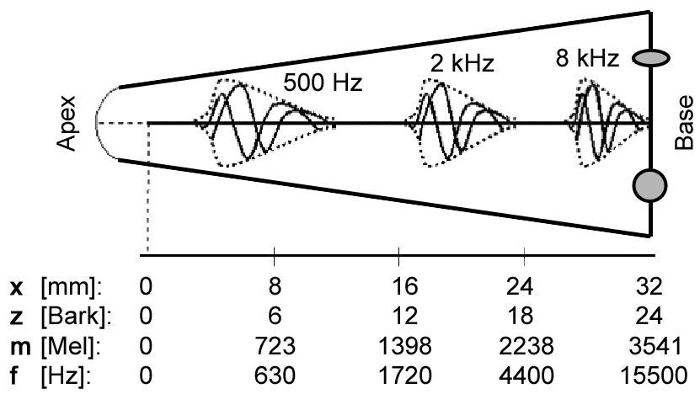
Tonotopy
Frequency scale of the ear :
The human basilar membrane (BM) is approx. 32-35mm long. Along the BM ca. 3500 IHCs and 12000 OHCs are distributed.
Regardless of whether we take Bark or Mel scale, it is important to remember that place pitch is not distributed linearly along the cochlea;
210±10 Hz we can discriminate well, but
4410±10 Hz will cause difficulties.
Pitch difference of 1 Bark roughly equals to 1.3 mm on the BM; you only have around 150 IHCs along that cochlear section.

Slide 32
Short recap
Outer ear: amplification, direction-dependent filtering.
Middle ear:
impedance matching (air to fluid),
protection of the inner ear.
Inner ear:
spectral decomposition of signal (~filter bank),
transformation into electrical signals (neural spikes).
Properties:
Frequency: non-linear (log-like) map.
Amplitude: compressive nonlinearity.
Source: www.lobe.ca, 2021.

Slide 33




Causes of hearing impairment
Malformation
Foreign body
Eardrum scars / malformation / perforation
Barotrauma (can be temporary)
Otitis media or Eustachian tube dysfunction (fluid in the middle ear)
Rigid joints between ossicles, otosclerosis
Aging (presbyacusis)
Exposure to loud noise
Trauma / Barotrauma / Head injury
Genetic or hereditary hearing loss
Viral infection of the hearing nerve
Malformation of the inner ear or tumor
Ototoxic drugs (antibiotics, some anti-inflammatory drugs, chemotherapy)
Impacted ear wax
Foreign body or fluid
Inflammation or infection
Malformation or tumor
Source: www.lobe.ca, 2021.

Slide 34
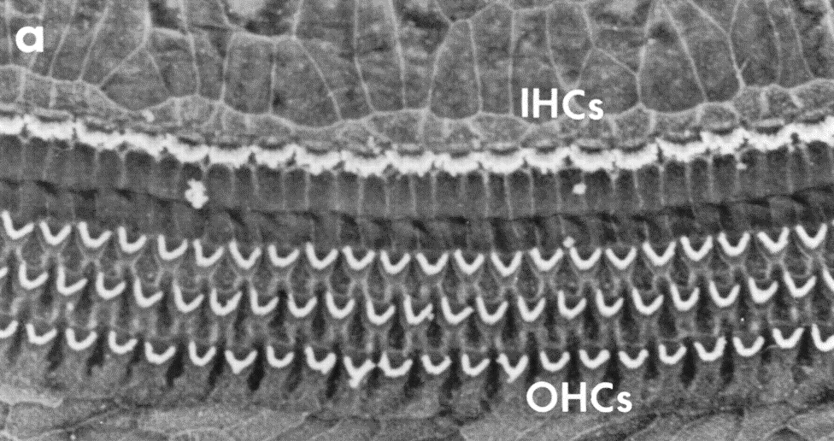
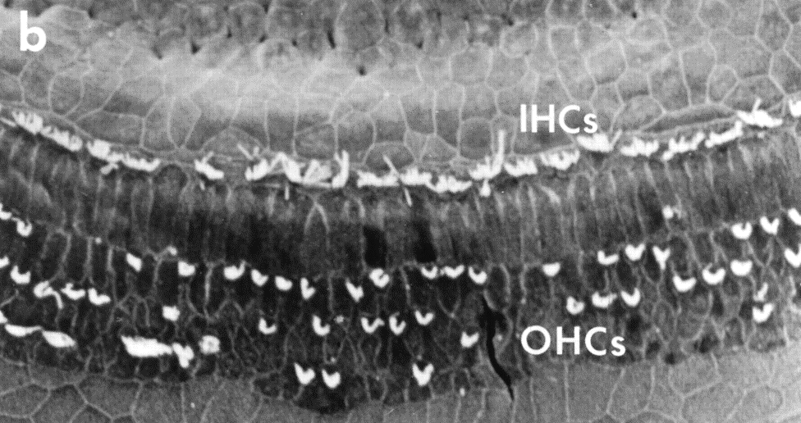

Causes of hearing impairment
Malformation
Foreign body
Eardrum scars / malformation / perforation
Barotrauma (can be temporary)
Otitis media or Eustachian tube dysfunction (fluid in the middle ear)
Rigid joints between ossicles, otosclerosis
Hair cell damage
Aging (presbyacusis)
Exposure to loud noise
Trauma / Barotrauma / Head injury
Genetic or hereditary hearing loss
Viral infection of the hearing nerve
Malformation of the inner ear or tumor
Ototoxic drugs (antibiotics, some anti-inflammatory drugs, chemotherapy)
Impacted ear wax
Foreign body or fluid
Inflammation or infection
Malformation or tumor
Source: Ryan, 2000
Source: www.lobe.ca, 2021.

Slide 35
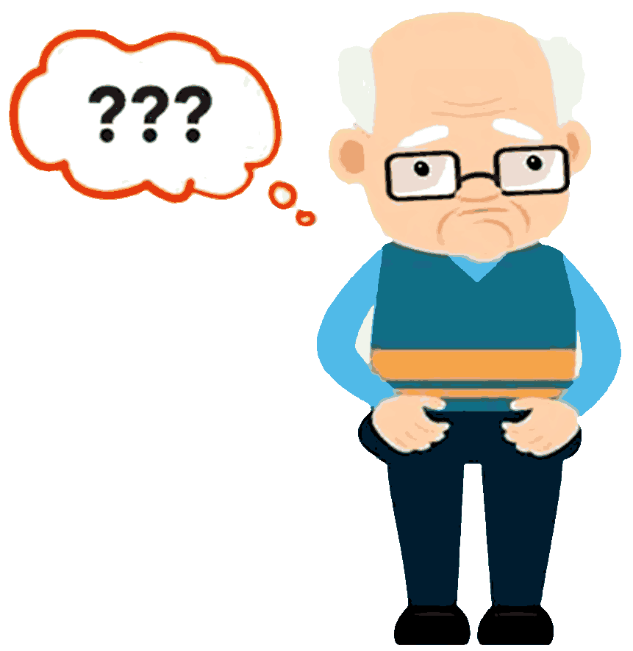
Consequences of hearing impairment
Communication is difficult to follow, uncertainties become frequent in everyday life.
Environmental sounds missing (bird song, water dripping, water boiling over when cooking, …).
Withdrawal, due to
missing what others are talking about → frustration;
unwilling to ask repeatedly → shame, embarrassment;
everyday situations become challenging;
listening to speech becomes very effortful.
Most of the time no sudden decline but a creeping process → unconscious adaptation.
Often leads to "pro-active strategy“: responses to what was meant to be said.
May lead to loneliness, isolation, depression (false sense of others often being angry with them).
Unavoidable cognitive decline if untreated.
Danger: confusion with dementia.

Slide 36

First signs of a hearing impairment #1
Speech at moderate level not always understood, but loud speech becomes disturbing and misinterpreted as offensive.
Threshold of pain
In most cases, the amount of energy arriving at the IHCs is comparable to that of the NH (normal hearing) case.
Threshold of pain is unchanged (and also the range of uncomfortably loud signals).
But the dynamic range is narrower.
In hearing assistive technology:
need to know the thresholds (pure tone audiometry),
need to apply dynamic compression.
Changed threshold of hearing

Slide 37
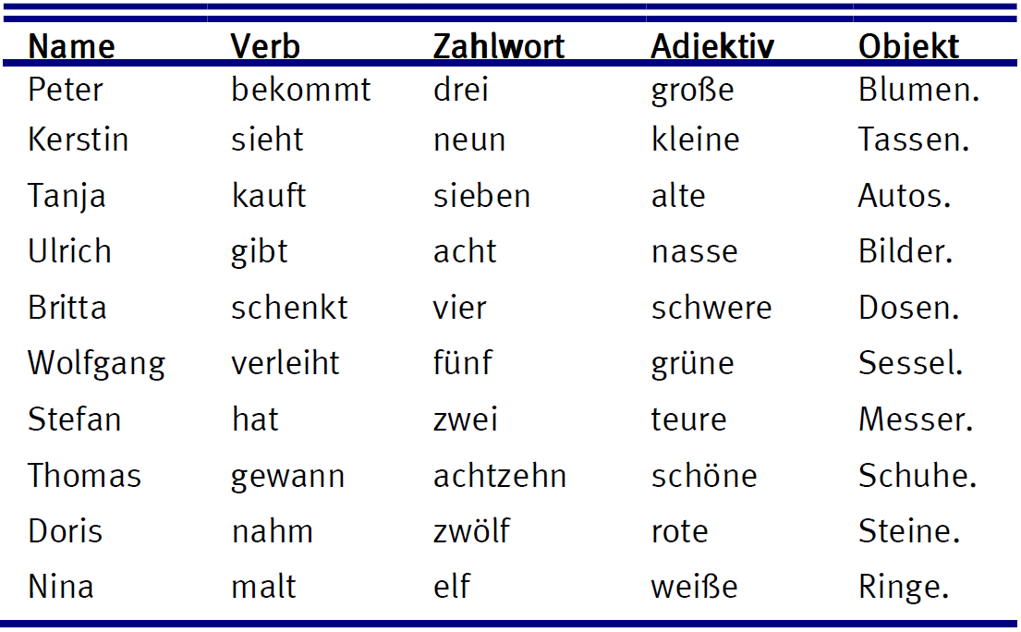
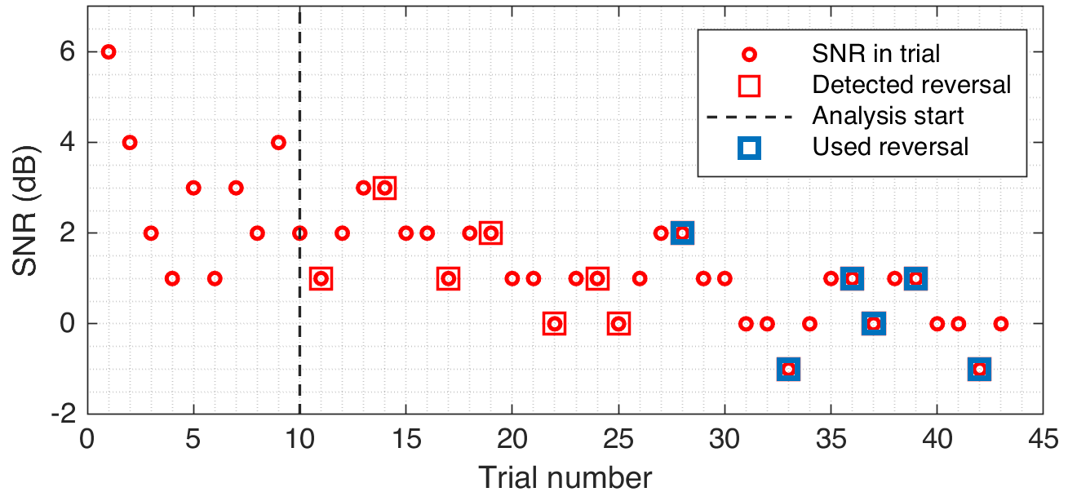
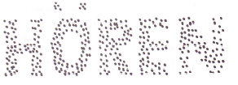
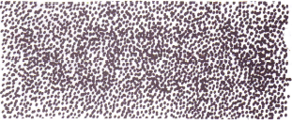
First signs of a hearing impairment #2
Understanding speech in noise (other talkers, traveling, background music) becomes increasingly difficult.
If pure tone audiogram looks OK → hidden hearing loss.
Speech in noise test can clarify the issue. In German-speaking regions: OLSA (Oldenburger Satztest).
Problems with understanding speech in noise often arise before a pure tone audiogram indicates hearing impairment. Speech reception threshold, SRT, increases.
Threshold and equal loudness curves may remain largely unchanged.
Frequency and amplitude resolution declines, which makes it the auditory system harder to distinguish signal from noise.
Hearing assistive technologies may help with signal reduction algorithms.
10 dB SNR
0 dB SNR
-6 dB SNR
SRT: 0.33 dB SNR

Slide 38
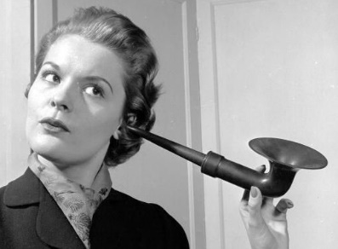
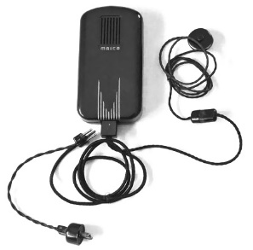
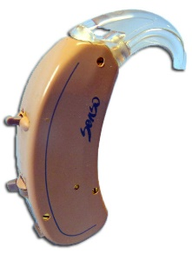
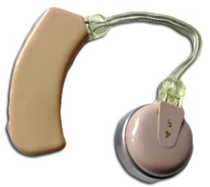
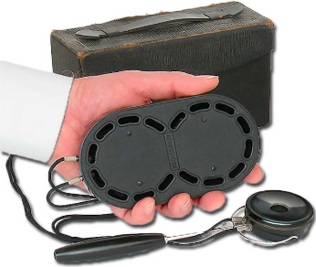
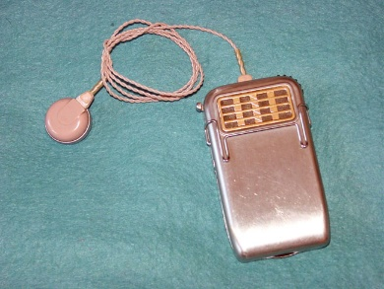
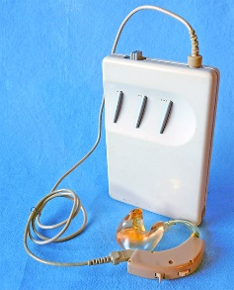
Hearing aids – Early history
Vactuphone (1st vacuum-tube HA)
Behind-the-ear hearing aids
Widex Senso full digital BTE HA
Ear trumpets
Source: hearingaidmuseum.com, 2021
17th century
1902
1921
1952
1956-57
1980s
1995
Hutchison’s Acousticon (1st electrical HA)
Sonotone Model 1010 (1st transistor HA)
Nicolet Phoenix (programmable digital HA)

Slide 39
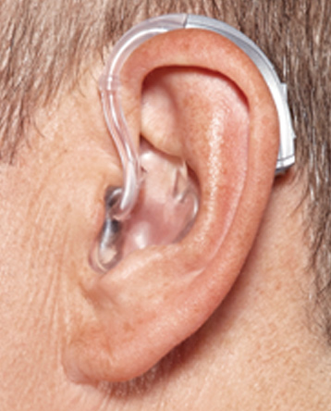
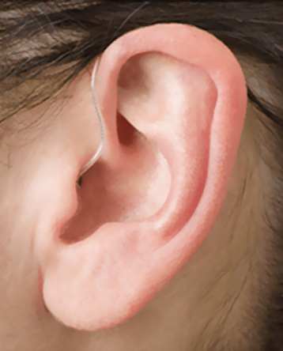
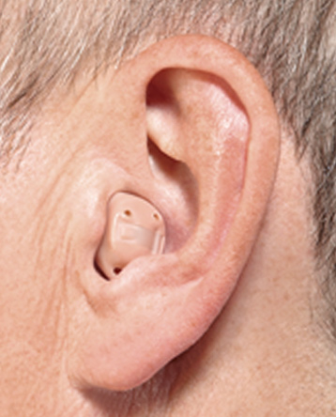
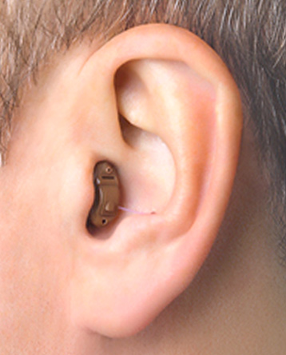
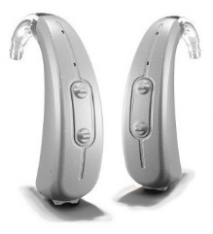
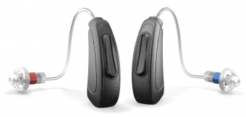
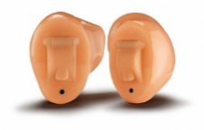

Hearing aids – Modern form factors
Source: betterhearing.org, 2021
Behind the ear (BTE)
Receiver in canal (RIC)
In the canal (ITC)
Completely in canal (CIC)
+ least earwax impact • definitely visible
+ least feedback
+ glasses-friendly - ear occlusion
+ glasses-friendly - ear occlusion - usability

Slide 40
Hearing aids – Modern requirements
Attested hearing impairment is a disability.
Health insurance (in Germany) pays for an adequate hearing aid system. Requirements:
digital technology;
a minimum of 4 frequency channels with compression;
a minimum of 3 selectable, individualized programs (=settings);
availability of noise reduction algorithm;
availability of feedback cancellation algorithm.
Plus, requirements of the Medical Device Regulation (MDR) of the European Union:
manufacturer must implement quality and risk management systems;
performance, user benefit, and user safety must be proven in clinical trials.

Slide 41



Hearing aids – Expected features
General:
Small, lightweight, intuitive, discrete*.
Remote control, smartphone app.
Wireless streaming (TV, remote microphone).
Quickly rechargeable, long lasting battery.
Audiological features:
Low noise, high bandwidth (10 kHz+).
16+ frequency channels for DRC.
Adaptive microphone directionality.
Noise reduction: ambient, wind, impulse.
Environmental classification.
Advanced feedback cancelation.
Frequency shifting.
Low latency (<< 10 ms), binaural algorithms.
vs

Slide 42






Next week

Slide 43
Thank you very much!
Questions?
Dr.-Ing. Tamas Harczos
tamas.harczos@audifon.com audifon GmbH & Co. KG

